Slide 1
TV CAMERA SHOTS
The eye of a producer

Slide 2
TV Camera Shots
The camera works on the principal of human eye and it shows what all the human eye watches through its lens. The eye retains the image for 1/16 second while the camera works at the speed of 25 frames per second and that’s why the fractions of frames or pictures seem to be moving on the screen.

Slide 3
Camera functions
The camera can be utilized as per the requirement of the shot, situation of the programs and the mood of the scene. There are following camera functions generally used in television productions.

Slide 4
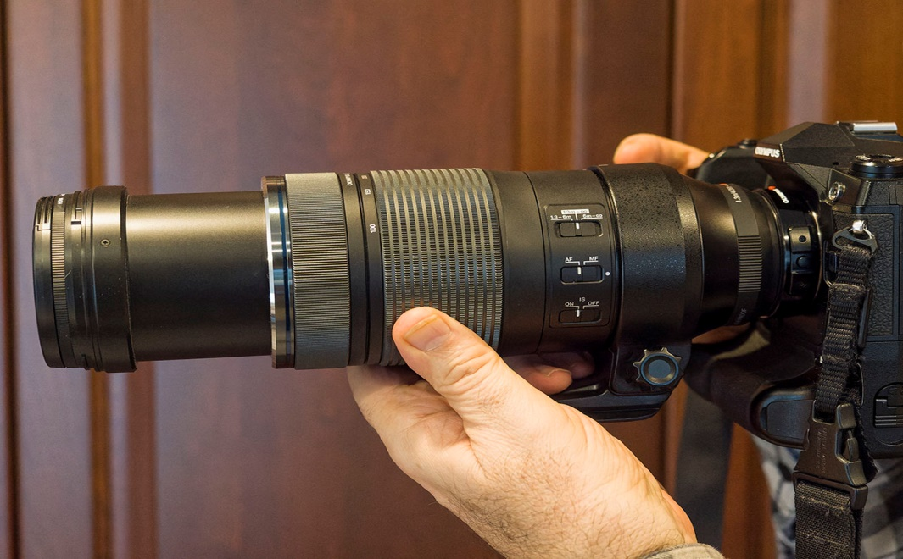
Movement of lens of camera
During this technique only lens of the camera is moved

Slide 5
Movement of lens of camera
Zoom in
Image coming close to viewer
Zoom out
Image going away from the viewer
Focus
Image becoming sharp
Defocus
Image getting blur

Slide 6
Movement of camera itself
During this technique camera it is moved

Slide 7
Movement of camera itself
Pan right
Camera is moved towards right side
Pan left
Camera is moved towards left side
Tilt up
Camera is moved upwards
Tilt down
Camera is moved downwards

Slide 8
Movement of camera with tripod
During this technique the camera is moved with the pedestal or tripod leaving its place as well.

Slide 9
Movement of camera with tripod
Dolly in
Camera is moved close to the object
Dolly out
Camera is moved away from the object
Track right
Camera is moved to the right side of the object
Track left
Camera is moved to the left side of the object

Slide 10
Assignment
Differentiate between Camera angles and Distance

Slide 11
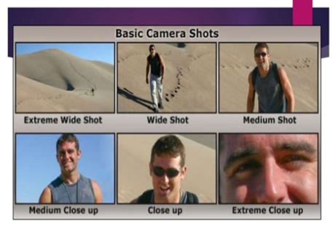
BASIC SHOTS

Slide 12
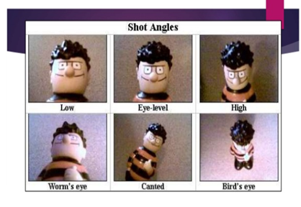
BASIC ANGLE

Slide 13
THANK YOU

